Slide 1
Image Style Transfer
CS 512 : Final Project
Saket Pallav (A20446310)
Aman Agrawal (A20446346)

Slide 2
Problem Statement
In view of creating new art in painting, artists always look to create something new. There is a type of painting they have mastered where they create a unique image by composing two images such that the content of one image is shown in the style of the other image. In this project, we have worked on creating such artistic images using an approach mentioned in the research paper (A Neural Algorithm of Artistic Style), which utilises the properties of Convolutional Neural Network in order to achieve this task. It can have wide applications specially in the field of graphic design and textile industry.

Slide 3
Background Material
A Neural Algorithm of Artistic Style - Leon A. Gatys, Alexander S. Ecker, Matthias Bethge
Deep Learning with Python - Francois Chollet
Blogs on towardsdatascience.com - Neural Style Transfer, Intuitive Guide to Neural Style Transfer, Neural Style Transfer and Visualization of Convolutional Networks
Blog on Medium.com - Image Style Transfer

Slide 4
Proposed Solution
Convolutional Neural Networks are used to train object recognition models. In this process, they develop a representation of the image that makes object information increasingly explicit along with the processing hierarchy.
Higher layers in the network capture the high-level content in terms of objects. However, lower layers simply reproduce the exact pixel values of the original image. So, we choose a feature map from a higher layer of the network for content representation.
Content is a macro-structure of the input image. Visual pattern, textures, colors are the style of the input image.
Inspired by deep learning algorithms, we minimize loss function for content and style during synthesis of new images.

Slide 5
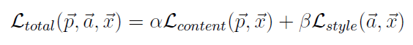
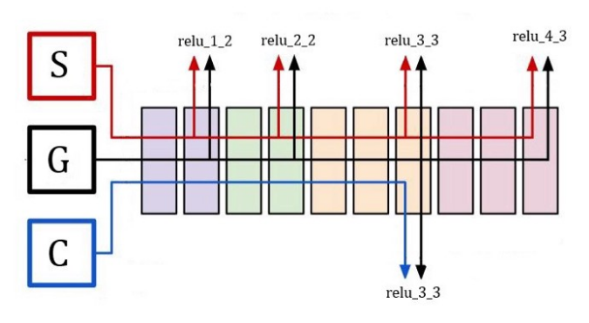
Proposed Solution continue...
The total loss function is given by:
The content and style loss functions are mean squared error between input images and the generated image.
The correlation of style loss is obtained by multiplying feature map and its transpose, resulting in the gram matrix.
The style of image is obtained from final layers of each convolution block of VGG19. For this, we use gram matrix to obtain a correlation between the style of the style image and the style of the generate image .
Calculating difference of gram matrices of the style image and the generated image gives us final style loss.

Slide 6
Proposed Solution continue...
In other words, we are using pre-trained layers of vgg19 to define a loss that will do the following:
Preserve content by maintaining similar high-level layer activations between the content image and the generated image.
The convnet should “see” both the content image and the generated image as containing the same things.
Preserve style by maintaining similar correlations within activations for both low- level layers and high-level layers.
Feature correlations capture textures: the generated image and the style-reference image should share the similar textures at different spatial scales.

Slide 7
Implementation Details
Take input content image and style image and resize them to 500 by 500
All the configurations required for the project are provided in a ‘config.ini’ file
Pre-trained layers of VGG19 are read by the Tensorflow library.
A copy of the content image is taken as the initial image, which over the course of iterations during the training process gets updated to the desired image with the style transferred from the style image.
We have used Adam optimizer to train the model.
Implementation Video

Slide 8
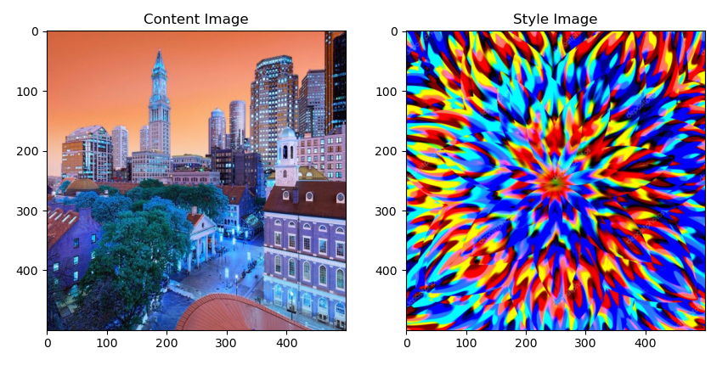
INPUT IMAGE
Content and style images

Slide 9
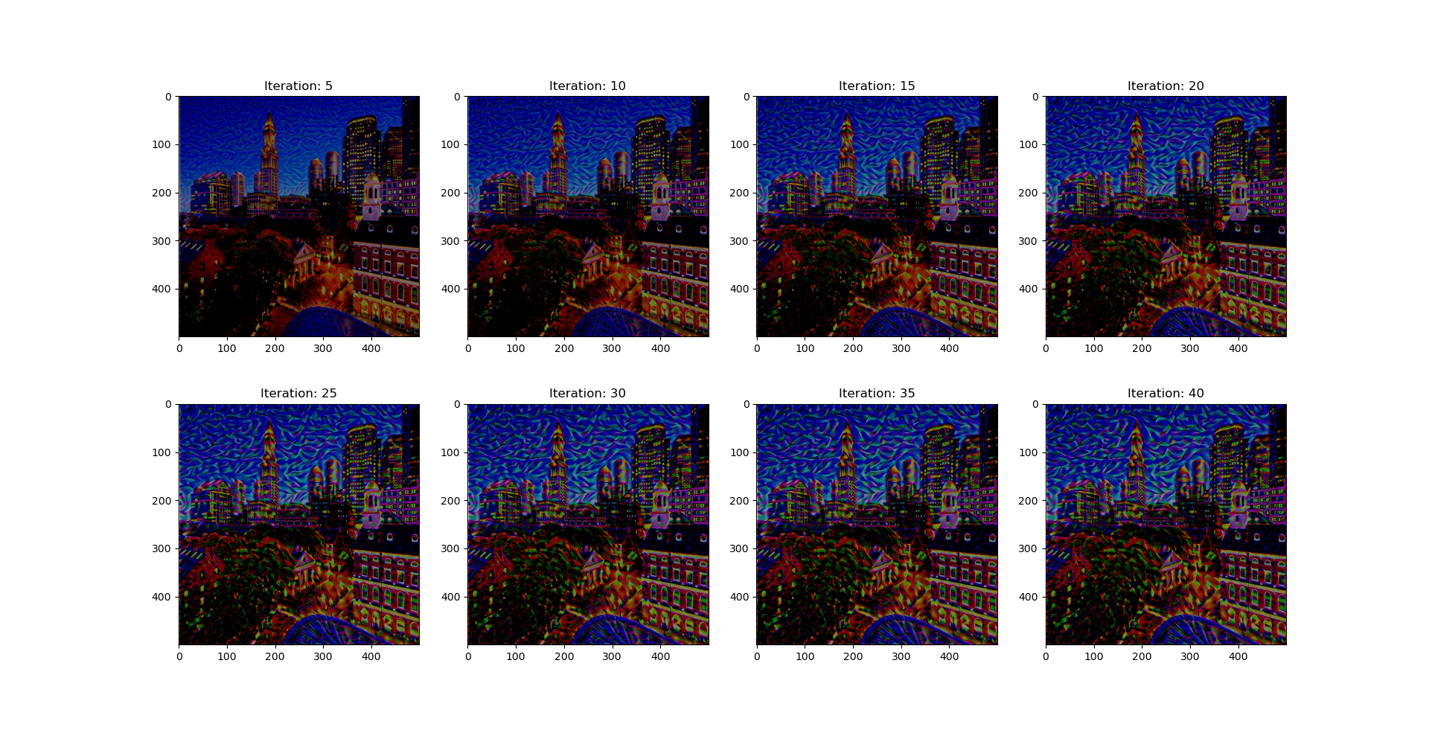
Results after every 5 iteration

Slide 10
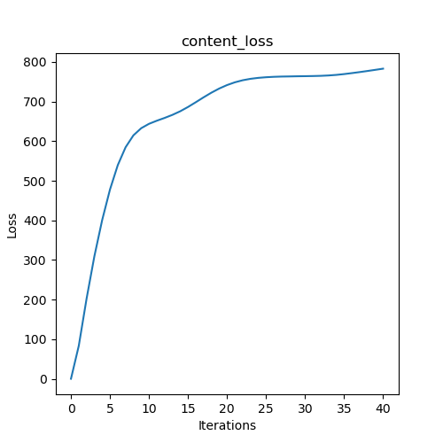
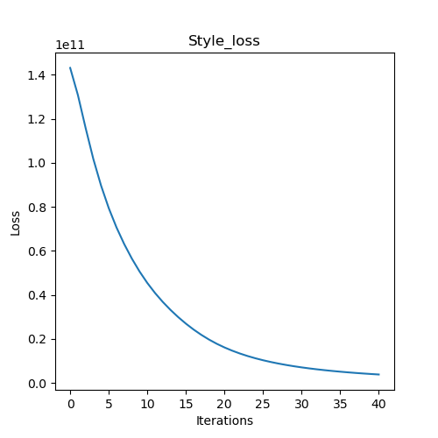
Loss Graph

Slide 11
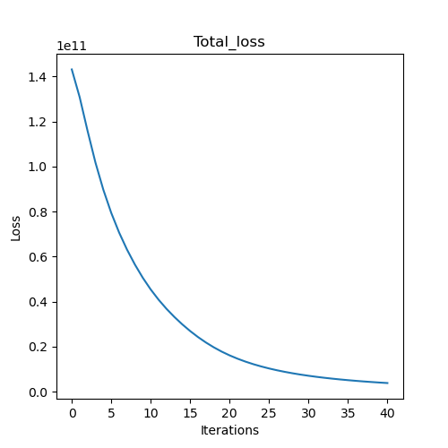
Loss Graph

Slide 12
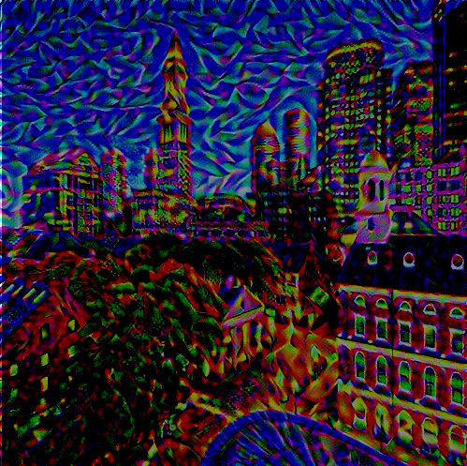
Final Result
Final result with
first style on
content image.

Slide 13
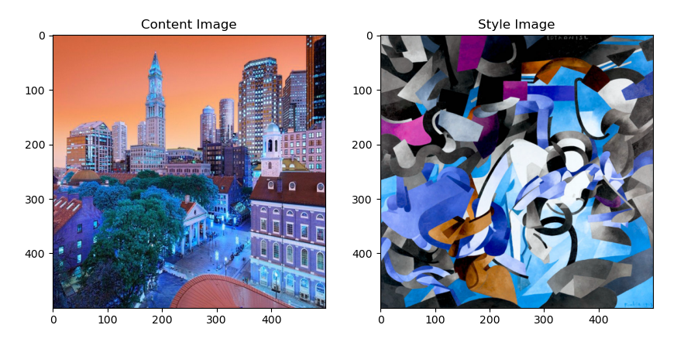
Input Image with Second Style
Content and style images

Slide 14
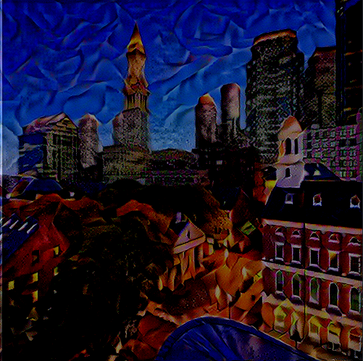
Final Result
Final result with another style on
same content image.

Slide 15
Conclusions
● As it can be seen from the content_loss graph, the content loss increases with the iterations
● This is expected, as the initial image taken is the content image itself. Thus, it has the maximum content similarity before training.
● But, the total loss decreases over time. This is because the style loss reduces over the training process
● And since the style loss has much higher weight than the content loss (of the magnitude of
1e-5) the style loss causes the total loss to reduce over the iterations.
● The final image generated primarily contains the content from the original image, but the style of the style image has been generated onto it.

Slide 16
THANKS!
Any questions?

